Slide 1
Bitcoin and anonymity

Slide 2
Anonymity basics

Slide 3
Some say Bitcoin provides anonymity
“ Bitcoin is a secure and anonymous digital
currency ”
— WikiLeaks donations page

Slide 4
Others say it doesn’t
“ Bitcoin won't hide you from the NSA's prying
eyes”
— Wired UK

Slide 5
What do we mean by anonymity?
Literally: anonymous = without a name
Bitcoin addresses are public key hashes rather than real identities
Computer scientists call this pseudonymity

Slide 6
Anonymity in computer science
Different interactions of the same user with the system should not be linkable to each other
Anonymity = pseudonymity + unlinkability

Slide 7
Why is unlinkability needed?
Many Bitcoin services require real identity
2. Linked profiles can be deanonymized by a variety of side channels
Notes:
If linked at any point, all tx’s identified – past, present and future
KYC principle
side channel example: transaction timing correlates with twitter postings

Slide 8
Defining unlinkability in Bitcoin
Unlinkability in Bitcoin context:
Unlinkability in Bitcoin context could have different meanings. It should be
Hard to link different addresses of the same user
Hard to link different transactions of the same user
Hard to link sender of a payment to its recipient
Even in this way, deductions might still be possible, for example, if numerous transactions for the same amount are made quickly and continuously forwarded from one address to another before they come to a stop.
What we want to ensure is that it is not feasible to link the sender and the ultimate recipient of the payment by looking at the block chain.

Slide 9
Quantifying anonymity
Anonymity set: is the size of the crowd of other addresses or transactions that we are trying to hide in.
with respect to some adversary, there are thousand other transactions that look just like yours, the adversary can't tell which one was really yours.
To calculate anonymity set:
define adversary model
reason carefully about: what the adversary knows, does not know, and cannot know
In addition, you can suppose how clever is the adversary, but it won't be an accurate information. So, in some cases, it would also be necessary to apply probability distributions on top of the anonymity set.
Notes:
In particular, techniques like “taint” aren’t very good

Slide 10
Ethics of anonymity: Why anonymous cryptocurrencies?
Block chain based currencies are totally, publicly, and permanently traceable
Without anonymity, privacy is much worse than traditional banking!
in fact, anyone could retrieve all your transactions, not only some company or government. So, we want anonymity to at least obtain the same level of privacy between cryptocurrencies and traditional systems. Of course people hope that it can give us a higher level of privacy.

Slide 11
Risk of money laundering What about money laundering?
Legitimate worry
Bottleneck: moving large flows into and out of Bitcoin (“cashing out”)
Common problem in computer security and privacy.
Because from a technological point, those uses that we consider to be very different morally are essentially the same.
Notes:
Researchers should work with AML. Pointer to next lecture
Even for traditional money laundering, difficulty is not technical but rather criminal penalties
Efforts to improve Bitcoin anonymity don’t solve the cashing out problem, so nothing to worry about there

Slide 12
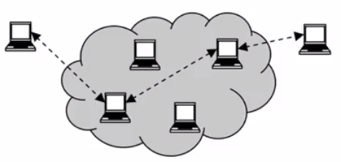
Tor
Some activities, good and bad, that can happen on the Tor network. Good used by:
Normal people who want to protect themselves from being trapped online by marketers or various other privacy properties online, when they're browsing websites
Journalists, activists and dissidents to not be recognised
Law enforcement since they want to be able to visit websites not revealing that their IP address is coming from a law enforcement block
Bad used by:
botnets to spread malwares between nodes in the network
Child pornographers
Funded by (among others):
U.S. State Department
Anonymous communication network
Anonymous communication enables bad actions at least as much as anonymous cash flows do.
Sender and receiver of message unlinkable

Slide 13
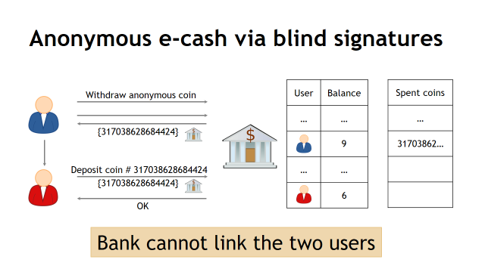
Anonymous e-cash
David Chaum, 1982
Blind signature: two-party protocol
Key Point:
User Identity is Known During the Request: The bank knows the user requesting e-cash, but only to ensure they have enough funds. This doesn't affect the anonymity of later transactions.
-Before receiving the 100, you create a blinded version of the e-cash token. Think of this as putting the 100 in a sealed envelope, hiding its details.
-The bank signs this blinded token, confirming it's worth $10, but they never see the actual token.
-The bank only knows it signed a $10 token, but it doesn't know the specific token you’ll use.

Slide 14
Summary:
In a regular transaction, your identity and purchase details are easily traceable.
In an anonymous e-cash system:
The bank knows who requested the e-cash but doesn’t know which specific token you’ll use.
When you spend the token , the transaction is anonymous—your identity is not linked to the purchase.

Slide 15
Anonymity & decentralization: in conflict
There are two reasons for this:
Interactive protocols with bank are hard to decentralize
often for anonymity it is necessary to rely on certain interactive protocols with the bank in order to do some blinding (i.e. blind signatures). It’s not clear if something like that could be possible without a central authority
Decentralization often achieved via public traceability to enforce security
even it was possible to obtain blinding in a decentralized system, there’s still the problem that in order to decentralize and still get security properties like resistance to double spending, often the way to go is to record and trace everything in a public ledger. So this compromises further the anonymity and privacy properties

Slide 16
How to de-anonymize Bitcoin

Slide 17
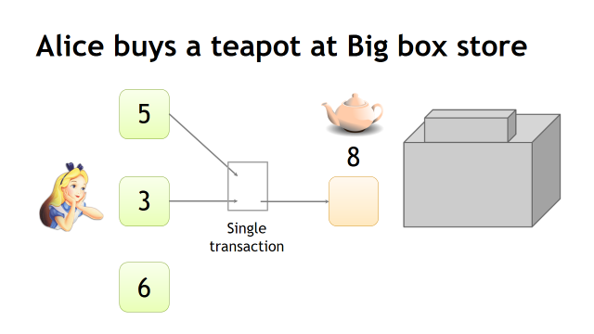
How to link different Bitcoin receiving addresses?
shared spending is evidence of joint control of two different addresses, and not only. The addresses can be linked transitively

Slide 18
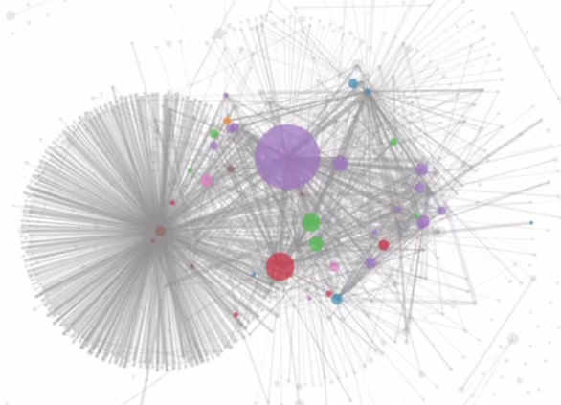
An Analysis of Anonymity in the Bitcoin System-Clustering of addresses
“An Analysis of Anonymity in the Bitcoin System” -F. Reid and M. Harrigan PASSAT 2011
Research results in the said paper:

Slide 19
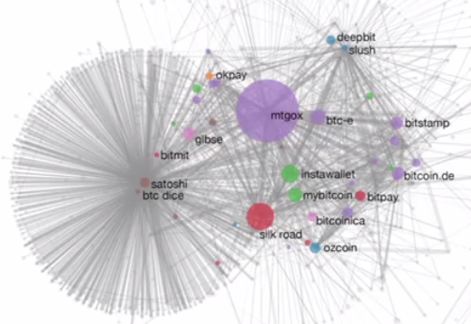
Based on the situation at the moment of the research, we can make some hypothesis, for example:
The biggest dot in violet could correspond to Mt.Gox, since it was the major exchange at the moment
While the small dot with many transactions could belong to Satoshi Dice gambling service. In fact, it received a lot of micro payments for gambling, so many transactions but without a lot of value.

Slide 20
Anonimity for individuals:
Bitcoin used to make transactions interacting directly with the merchant. So it is possible to link an address to the individual and start from there to identify the cluster.
Most users interact with big service providers who know their real identities. It is enough to find a single transaction with these big providers to potentially go back to the real identity. Of course, this is only possible with enough autority power or with hacking techniques.
Often users publish online some of their addresses for donation purposes or similar. With this single address it is possible to reconstruct the cluster.
“A Fistful of Bitcoins: Characterizing Payments Among Men with No Names” S. Meiklejohn et al. IMC 2013

Slide 21
Mixing

Slide 22



To protect anonymity, use an intermediary
You Get Untraceable Bitcoin
The Bitcoin you receive is anonymized, making it hard for anyone to trace it back to you.

Slide 23
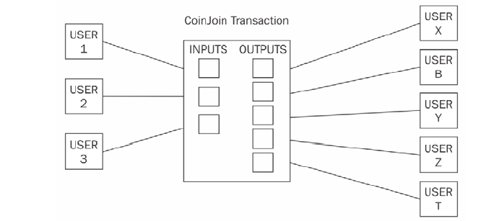
Mixing protocols:

Slide 24
Why decentralized mixing?
No bootstrapping problem
Theft impossible
More philosophically aligned with Bitcoin.
it makes possible to get rid of the need centralized service. Then, there are a lot of Bitcoin users who find that appealing.
Possibly better anonymity

Slide 25
Coinjoin
Each signature is entirely separate
This is 1 mixing round
Mixing principles from before apply on top of basic protocol
Single
transaction
Proposed by Greg Maxwell, Bitcoin core developer

Slide 26
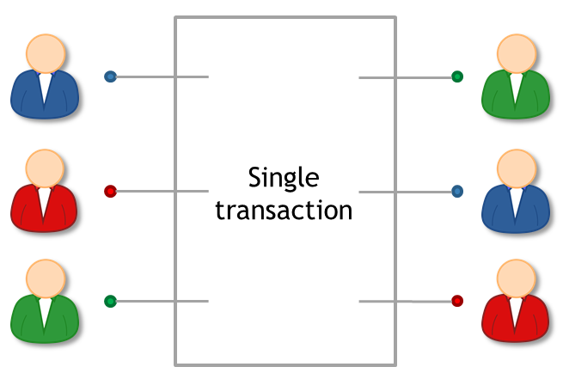
Coinjoin algorithm
Find peers who want to mix
Exchange input/output addresses
Construct transaction
Send the transaction around.Each peer signs after verifying their output is present
Broadcast the transaction

Slide 27
Coinjoin: remaining problems
How to find peers
Peers know your input-output mapping (This is a worse problem than for centralized mixes)
Denial of service

Slide 28
Series of mixes
Mix 1
Mix 2
Mix 3
Notes:
Generate a fresh address
Same principle behind Tor
Ideally we want all transactions to look identical, which motivates…

Slide 29
Principles for mixing services
1. Use a series of mixes
Mixes should implement a standard API to make this easy
2. Uniform transactions
In particular: all mix transactions must have the
same value!
“Chunk size”
3. Client side must be automated
Desktop wallet software
4. Fees must be all-or-nothing
Probabilistic fees:
0.1% mixing fee =
mix will swallow chunk
with 0.1% chance
Mixcoin: Anonymity for Bitcoin with accountable mixes
J. Bonneau et al.
Financial Cryptography 2014
Example:
If you send 1 Bitcoin to the mixing service, there’s a 0.1% chance that a small portion of it (say, 0.001 BTC) will be taken as a fee.
In 99.9% of cases, no Bitcoin is taken as a fee, but in the rare cases (0.1%), the service will keep that portion.

Slide 30
Third –party mixing protocols
have been proposed for Bitcoin privacy include:
-- CoinSwap
--TumbleBit
-- Dandelion
https://bitcointalk.org/index.php?topic=321228 about CoinSwap
https://eprint.iacr.org/2016/575.pdf about TumbleBit

Slide 31
Conclusion:
Bitcoin mixing services provide anonymity by breaking the direct link between a user and their Bitcoin's transaction history.
While effective for privacy, the use of such services is often scrutinized by law enforcement, as they can be misused for illegal activities like money laundering.

Slide 32
Zero coin and Zero cash
ZeroCoin was initially proposed as a privacy extension to Bitcoin. It aimed to add anonymity to Bitcoin transactions.
The concept of ZeroCoin eventually evolved into Zcoin, which is now known as Firo (a privacy-focused cryptocurrency).
ZeroCash was developed as an evolution of ZeroCoin, offering more efficient and secure privacy.
It formed the basis of the cryptocurrency Zcash, which is a well-known privacy-centric cryptocurrency.
With Zcash, users can choose between transparent and shielded transactions, providing flexibility in how much privacy they want.

Slide 33
Zero-knowledge proofs
introduced by Goldwasser, Micali, and Rackoff in 1985
Three properties of ZKPs that are required:
-- Completeness
-- soundness.
-- zero-knowledge property

Slide 34
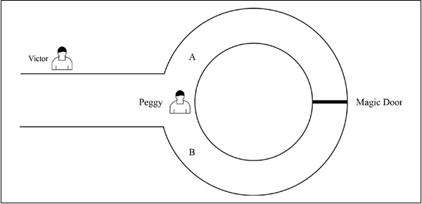
The steps that are taken by both Peggy and Victor to reach a conclusion regarding whether Peggy knows the secret or not:
1.First, Victor waits outside the main cave entrance and Peggy goes in the cave.
2.Peggy randomly chooses either the A or B entrance to the cave.
3.Now, Victor enters the cave and shouts either A or B randomly, asking Peggy to come out of the exit he named.
4.Victor records which exit Peggy comes out from.
Analogy of the zero-knowledge mechanism

Slide 35
Peggy and Victor repeatedly performing this routine proves knowledge of the secret with high probability.as probability of guessing or getting lucky reduces to the point of being negligible after n number of rounds.

Slide 36
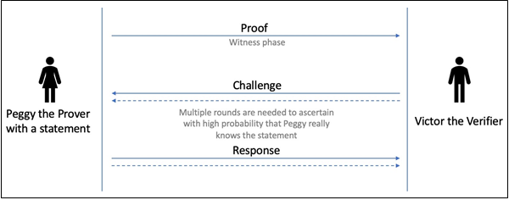
A ZKP comprises the following phases:
1.Witness phase: In this phase, the prover sends proof of the statement and sends it to the verifier.
2.Challenge phase: In this phase, the verifier chooses a question (challenge) and sends it to the prover.
3.Response phase: In this phase, the prover generates an answer and sends it as a response to the verifier. The verifier then checks the answer to ascertain whether the prover really knows the statement.
A zero-knowledge proof scheme

Slide 37
Applications of ZKP :
--proof of ownership
that is, proof that the prover is the owner of some secret or a private key without revealing the nature of it
--proof of age
where the prover proves that they are, for example, older than 25 years, but do not want to reveal their exact age
--Another application could be where citizens can pay taxes without revealing their income.
zk-SNARKs
The zk-SNARK is a variant of ZKPs that is more efficient and simpler to use and implement.

Slide 38
Zk-SNARKs Properties:
Zero knowledge (zk): This property allows a prover to convince a verifier that an assertion (statement) is true without revealing any information about it
Succinct (S): This property allows for a small proof that is very quick to verify and is succinct.
Non-interactive (N): This property allows the prover to prove a statement without any interaction with the verifier.
ARguments of Knowledge (ARKs): These are the arguments to convince the verifier that the prover's assertion is true.
Remember that we discussed soundness and completeness earlier. In the case of ARKs, the prover has a computational soundness property, meaning that the prover is computationally bounded, and it is computationally infeasible for it to cheat the verifier.

Slide 39
The biggest criticism of zk-SNARKs is the initial trusted setup
zk-STARKs
Zero-knowledge Scalable Transparent ARguments of Knowledge (zk-STARKs) are a new type of ZKP that has addressed limitations in zk-SNARKs.

Slide 40
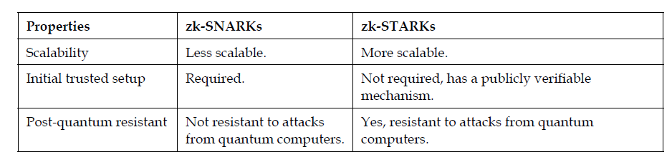
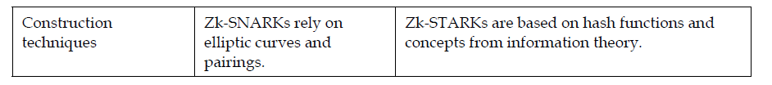
The key differences between the zk-STARK and zk-SNARK :

Slide 41
5 levels of anonymity
System | Type | Anonymity attacks | Deployability
Bitcoin | Pseudonymous | Tx graph analysis | Default
Single mix | Mix | Tx graph analysis, bad mix | Usable today
Mix chain | Mix | Side channels, bad mixes/peers | Bitcoin-compatible
Zerocoin | Cryptographic mix | Side channels (possibly) | Altcoin
Zerocash | Untraceable | None | Altcoin, tricky setup
Notes:
Engineering complexity, believability

